Slide 1

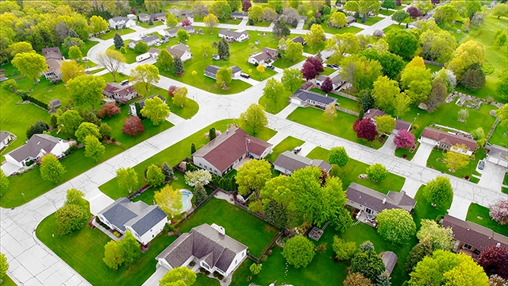


King county housing data analysis
EVAN STAFFEN

Slide 2

AGENDA
Stakeholder
Dataset
Modeling
Conclusions + Next Steps

Slide 3
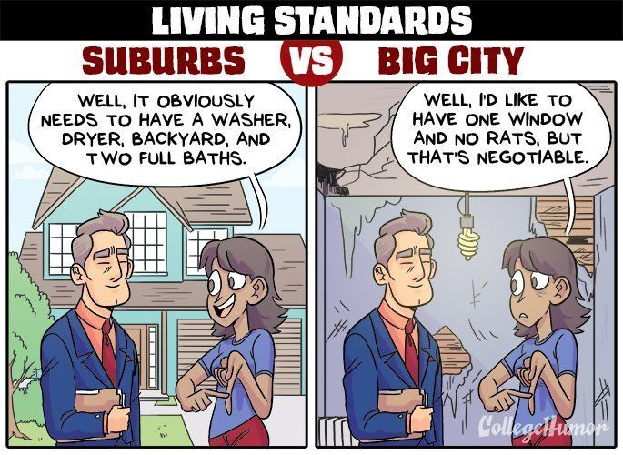
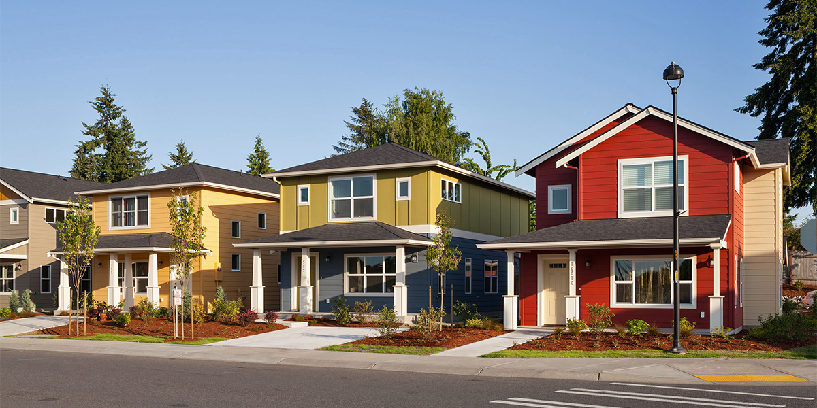
Business problem
The Johnson family recently had their first child. While they have loved living in New York City, they want more space and a relaxed lifestyle for their child. They have decided they want to move to King County, and I have been tasked with finding a house in the area that matches their needs.
Demands: Cannot spend more than $500,000, needs 2 bedrooms and not in Seattle
Notes:
Ever since COVID, they’ve realized the city lifestyle isn’t for them.
They want to raise their child in a different environment
State the demands

Slide 4
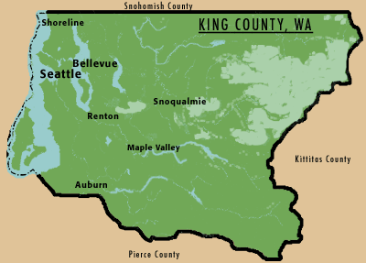
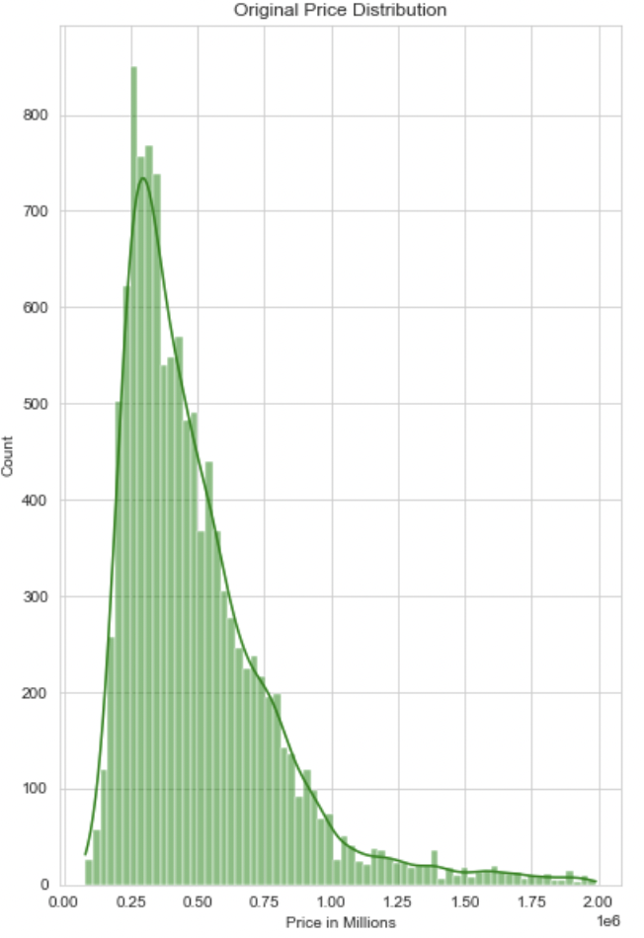

King County dataset
Housing data from King County, Washington
2014-2015
Housing Price Distribution
Notes:
King Country description (Seattle and how they don’t want that)
Removed all zipcodes that were in Seattle
Distribution of prices, right skew, as expected

Slide 5
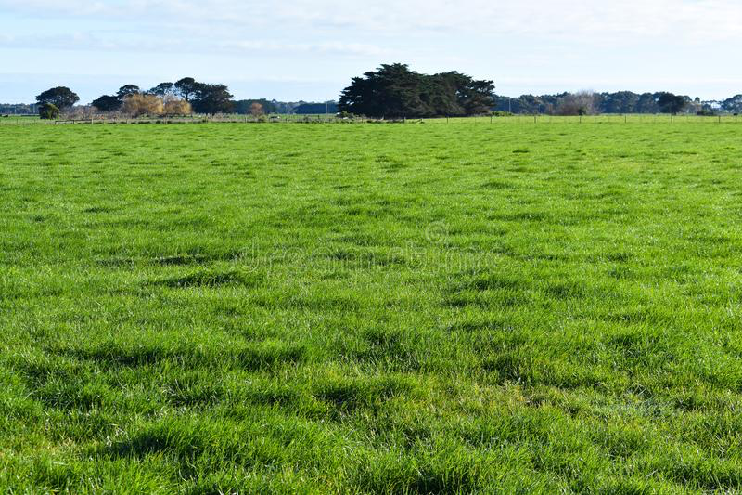
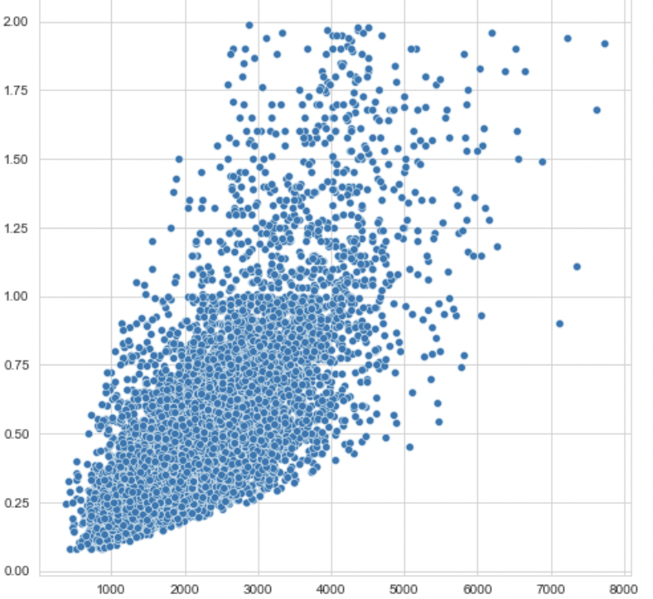
BASELINE MODEL
Model 1 R² (accuracy) = 0.553
Square Feet of Living Area vs Price
Price in millions
Square Feet of Living Area
Notes:
Quick initial scan of data shows that square foot tends to be most correlated with price, so baseline model was created with just that

Slide 6
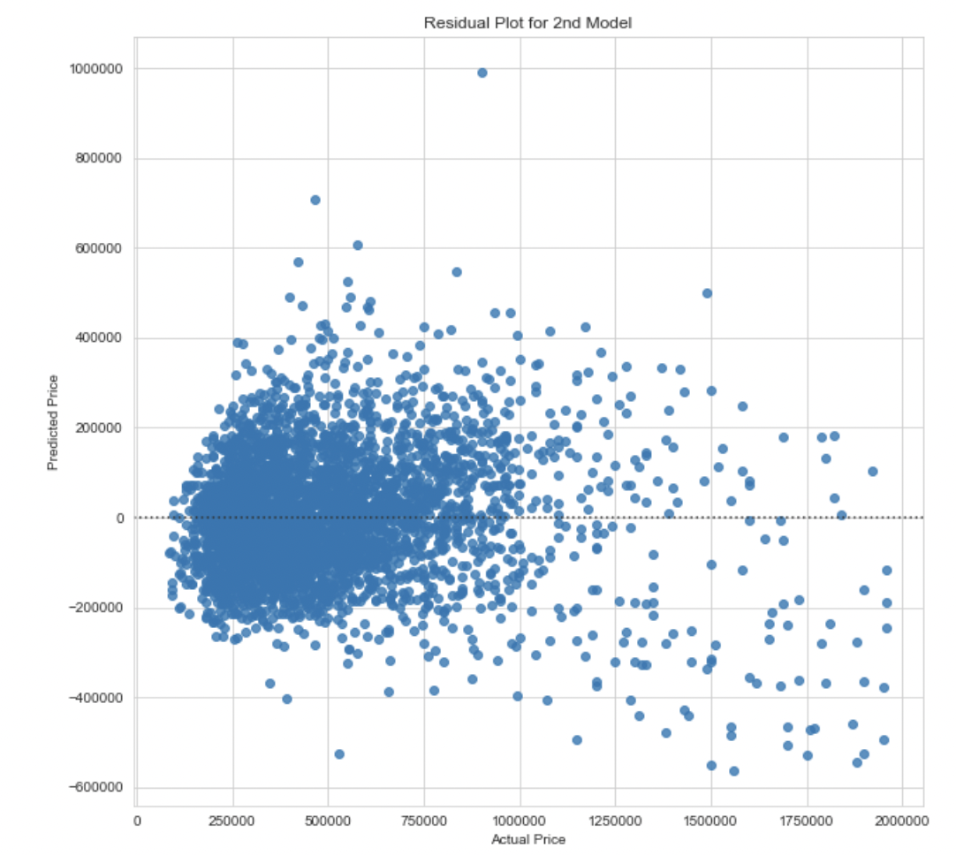
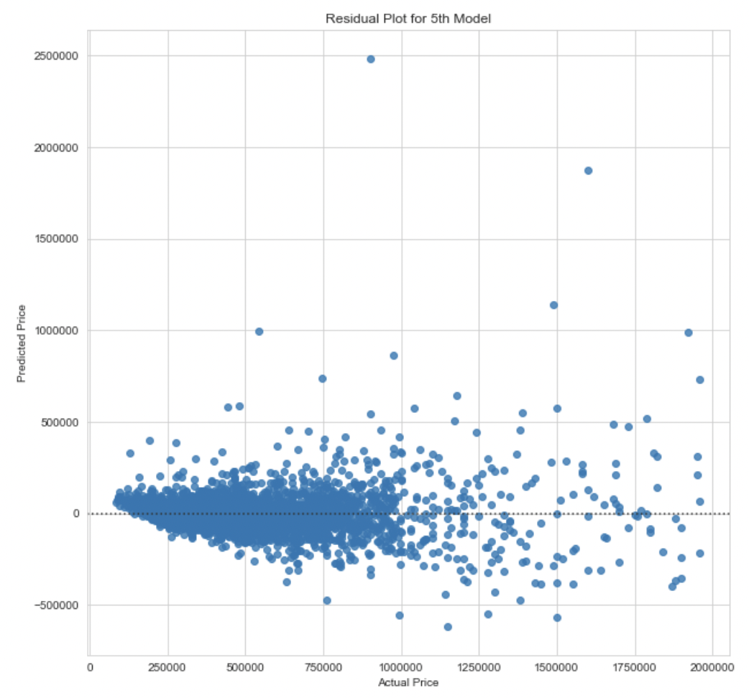
More Modeling
Five models created to predict price of houses
Model 2: R² (accuracy) = 0.667 Model 5: R² (accuracy) = 0.882
Predicted Price – Actual Price
Predicted Price – Actual Price
Actual Price
Actual Price
Notes:
2nd Model took into account all independent variables (over 80 different predictors)
y-axis = predicted price-actual price x=actual price
5th model took into account the predictors that seemed most correlated with price of a house as well as removing multicollinearity
A residual plot shows the difference between the observed response and the fitted response values.

Slide 7
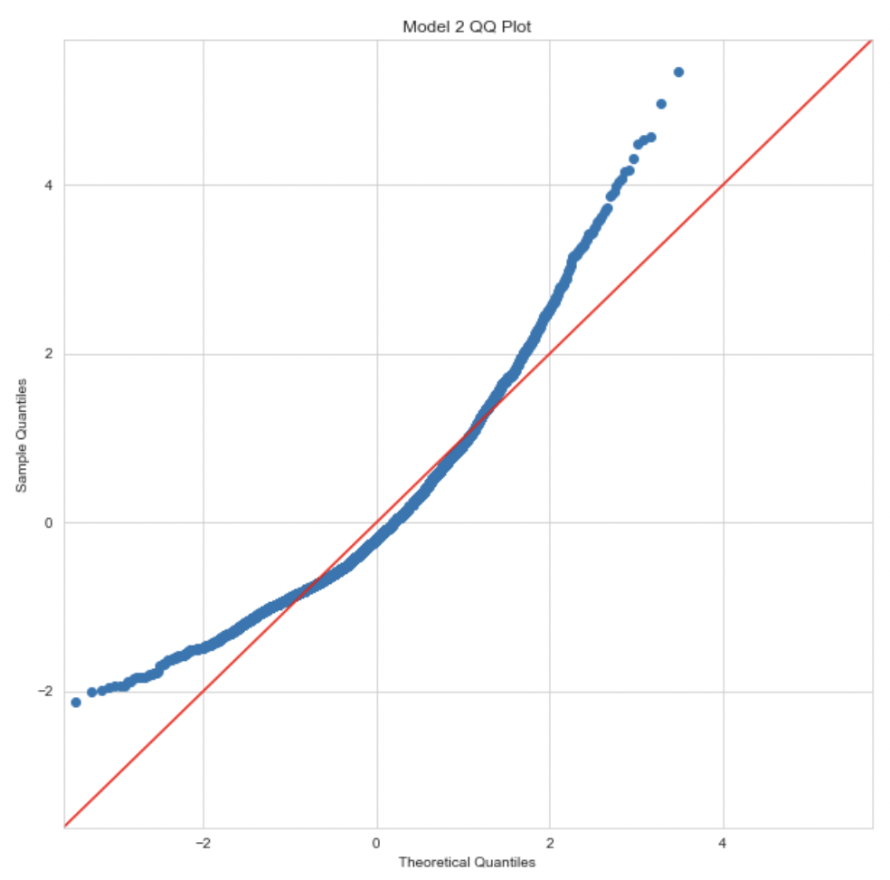
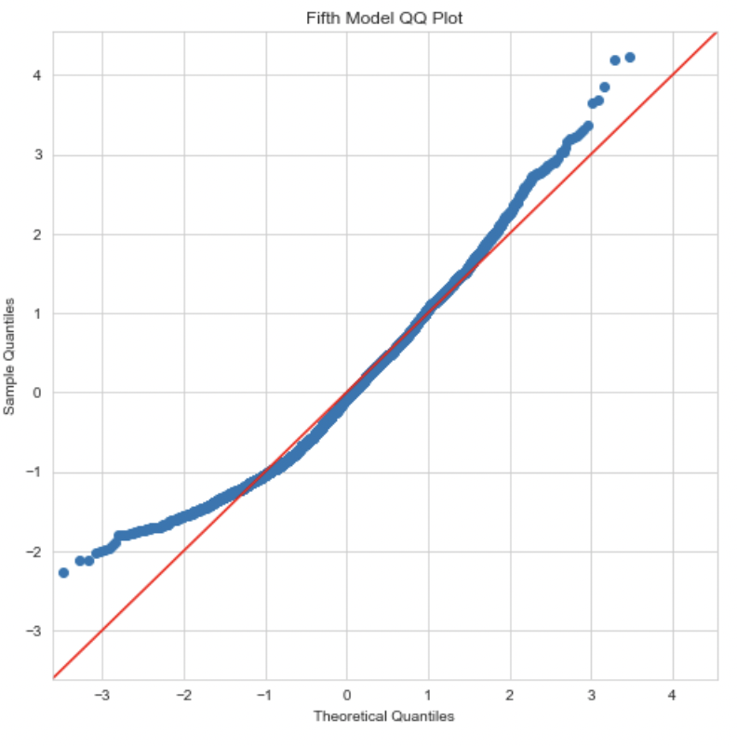
Second model QQ Plot Fifth model QQ Plot
Model 2: R² (accuracy) = 0.667 Model 5: R² (accuracy) = 0.882
Error = ± $116,395.59 Error = ± $63,776.51
Notes:
quantiles are cut points dividing the range of a probability distribution into continuous intervals with equal probabilities
Ideally want the blue to be matching the 45 degree redline, y-axis is sample price and x-axis is the theoretical price
A probability plot compares the distribution of a data set with a theoretical distribution
Ideally QQ would be on redline, as sample price is y and predicted price is x
2nd model off by 160000 dollars
5th model, off by 63000 dollars

Slide 8
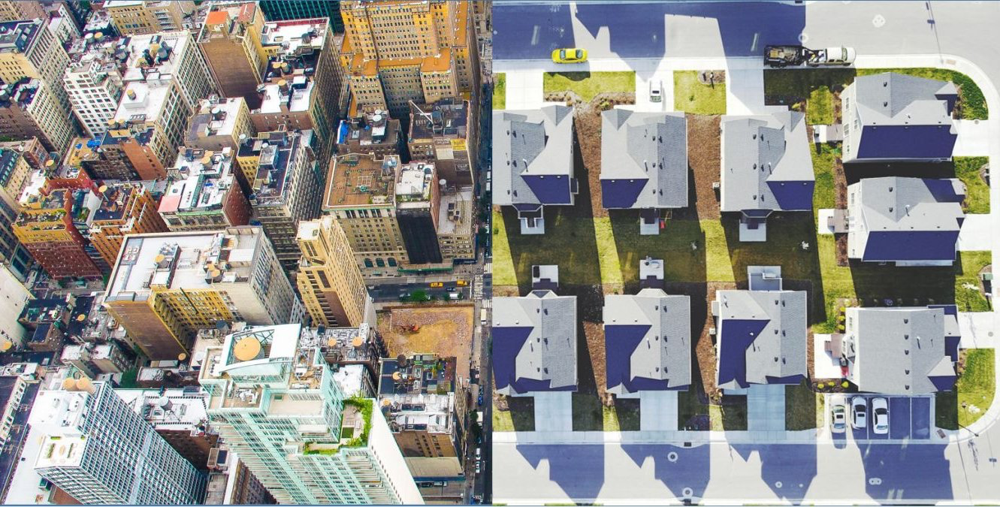
Final model (88.2% Accuracy)
Predictors
Waterfront (Y/N)
Bedrooms
Bathrooms
Sqft_living
Sqft_lot
Floors
Yr_built
Condition (1-9)
View (1-4)
Notes:
Takes into account 9 predictors total
63776.51

Slide 9

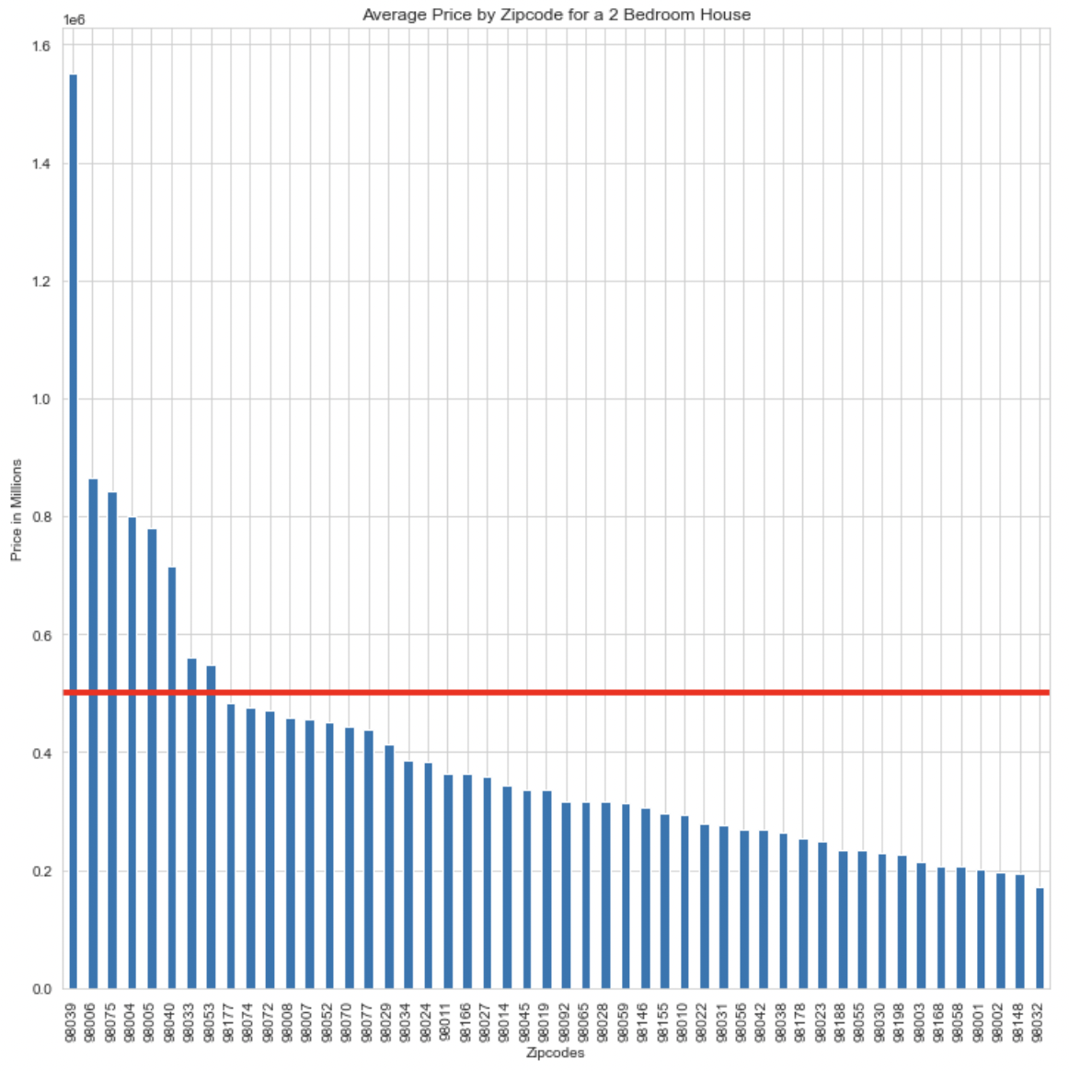

Average Price of a 2 Bedroom House Outside of Seattle
Price in Millions
Johnson Family Budget
Just 8 zip codes have an average price outside of their range!
Zip codes
Notes:
Many options available, very affordable for the johnsons to get a two bedroom house in the suburbs of King County.

Slide 10



CONCLUSIONS and NEXT Steps
King County has plenty of affordable, suburban options for the Johnson’s that match their needs.
In fact, the Johnson’s likely could spend much less than their budget in many zip codes
Data more recent than 2014-2015
Data on the nearest towns, schools and hospitals in these specific zip codes

Slide 11

Questions?

Slide 12

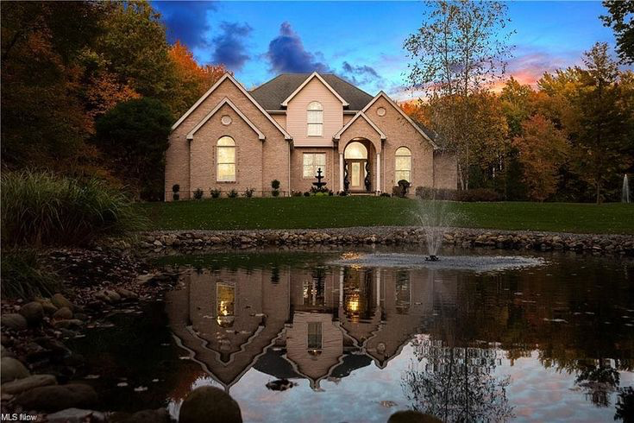
Contact
Github
https://github.com/evanstaffen/Housing-Dataset-Analysis
LinkedIn
https://www.linkedin.com/in/evan-staffen-a74045207/
Email
evan.staffen@gmail.com

